Slide 1

Ansible : Simple IT Automation

Slide 2
Ansible
Ansible is an open-source automation engine that automates software provisioning, configuration management, and application deployment. Ansible can manage any *NIX platform through the SSH.
Feature of Ansible
Cross platform support – can support any *NIX, Windows machines, network devices etc.
Agent less Architecture , so no work for system admins to manage the agents ☺
Written in Python.
Use OpemSSH for *NIX systems and WinRM for communication with MS Windows machines.
Open source and activity maintained on the github.
Very easy installation and configuration.
Highly scalable.
Secure as it used SSH for the communication.
Easy to understand and remember the command syntax. (No coding skills needed)
Ansible is not just automation engine , but it is also used for :
Configuration Management.
Application Deployment.
Orchestrations
Provisioning ( AWS, Virtual,Openstack etc)

Slide 3
Key Components
Ansible Modules.
Inventory.
Tasks.
Variables.
Playbooks
Further to the playbooks , Ansible roles can be configured for the more systematic management of the Ansible playbooks.

Slide 4

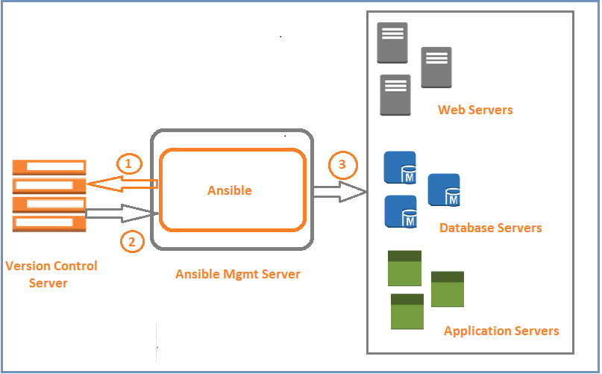
Ansible Agent less Architecture

Slide 5
Installation :
Using YUM
# yum install epel-release
# yum install ansible
Using PIP
# yum install python-pip
# pip install ansible
Checking the Ansible Version and Config Info
# ansible --version
Ansible Configurations (default)
Default Config Directory Default Config File Default Inventory File
:
:
:
/etc/ansible
/etc/ansible/ansible.cfg
/etc/ansible/hosts
Configuring communication between Ansible and target machines
When Ansible communicates with the target machines, by default it assumes the ssh keys are exchanged and password less communication is through. If you want to use the password , can hardcode the password in the
inventory file ,but this is not recommended. Also use ssh-keys for comms.
Step 1. Generating the Keys on Ansible Server:
# ssh-keygen
Step 2. Update Keys on Remote Host
# ssh-copy-id user@TargetServer
Step 3. Testing the Public Key Authentication
# ssh user@TargetServer

Slide 6
LAB 1 : 30 mins
Tasks :
Install Ansible using PIP on your RHEL/CentOS 6/7 Machine.
Configure and test the public key authentication between Ansible and Target Machines.
Configure sudo rules for “ansadm” user.
Have a look into ansible version and configuration files.
Any doubt – Ask questions ???

Slide 7
Ansible Inventories
Ansible is used for managing multiple servers in the Infrastructure. The collection of hosts is known as "Ansible Inventory”. An inventory is a text file listing hostnames usually grouped by functionality.
Recommendations on the Inventory
Give inventory nodes a human friendly names rather than just putting the IP addresses or DNS hostnames.
Always group the resources of similar functionality/function.
Maintain accurate information in the inventory file by having a single source of truth (if using static inventories).
Types of Ansible Inventories:
Static Inventory
Dynamic Inventory
Static Inventory
Static inventory is default inventory and is defined in the /etc/ansible/ansible.cfg file. Default file can be changed inside the ansible.cfg file. If you want to use custom file as inventory input can specify it using " -i /path/to/file " with Ansible command line.
Example of Static Inventory:
# cat /etc/ansible/hosts
[all]
app-apache-finance db-mysql-marketing
ansible_host=appserver1.opensky.home ansible_host=dbserver1.opensky.home
[appservers]
app-apache-finance
ansible_host=appserver1.opensky.home
[dbservers]
db-mysql-marketing
ansible_host=dbserver1.opensky.home
[webserver-apache] apache[01:50].example.com

Slide 8
Dynamic Inventory
If you have setup where you add and remove the hosts very frequently, then keeping you inventory always up-to- date become a little bit problematic. In such case Dynamic inventory comes into picture, generally are scripts (Python/Shell) for dynamic environments (for example cloud environments)
With Ansible, as aforementioned, can use "-i" to specify the custom inventory file.
For example, if you use AWS cloud and you manage EC2 inventory using its Query API, or through command-line tools
such as awscli , then you can make use of dynamic inventory,.
Dynamic inventory got benefits over static inventories
Very less manual efforts for managing the inventories.
Reduces human error, as information is collected by scripts.
Ansible have inventory collection scripts for the below platforms
AWS EC2 External Inventory Script , Collber,OpenStack,BSD Jails, Google Compute Engine and Spacewalk.
Information Source: http://docs.ansible.com/ansible/intro_dynamic_inventory.html
For quick demo I have downloaded the Ansible Dynamic inventory script and related ec2.ini file from Ansible web
site.
dynamic-inven-ec.py
ec2.ini
-
-
EC2 external inventory script (Python Script)
Contains Ansible EC2 external inventory script settings
In the dynamic inventories, grouping can be managed by “tags,regions etc inside the ec2.ini file.

Slide 9
Using Inventories for selecting the Target hosts
Example Static Inventory
# ansible -i /etc/ansible/hosts.ini -m ping all
In the above example, Ansible will check ping status of all server part of group “all”
Example Dynamic Inventory
# ansible -i dynamic-inven-ec.py -u ec2-user tag_Name_awslab* -m ping
In the above example, Ansible will do ping test for servers collected by dynamic inventory with tag key Name and Value with suffix “awslab”.

Slide 10
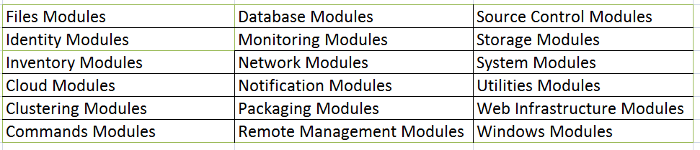
Ansible Modules
Modules (also referred to as “task plugins” or “library plugins”) are the ones that do the actual work in
ansible, they are what gets executed in each playbook task .
Following are the Ansible modules available as on date.
Information Source : http://docs.ansible.com/ansible/modules_by_category.html
Confused ??? Let’s check all available modules on the Ansible server. List all modules avaibale with that particular Ansible version
# ansible-doc -l
Check information of particular module
# ansible-doc <module>

Slide 11
Quick hands on Ansible Modules and Adhoc Commands
Check reach ability of the target systems
# ansible –m ping all
Check detailed information of the target machines
# ansible –m setup all
Execure adhoc commands on the target machiones
# ansible -m shell -a "uname -a" all -s
-s means command will be executed with sudo permissions.
List hosts on which command will be executed
# ansible -m shell -a "uname -a" all --list-hosts
Copy file from Ansible server to target machines using the copy module
# ansible -m copy -a "src=/tmp/testfile dest=/tmp/testfiletarget mode=700" all
Let’s look what Ansible is doing in the backgrouond
# ansible -m shell -a "uname -a" all -vvv
-vvv is the verbose

Slide 12
LAB 2 : 30 mins
Tasks :
Install httpd and ntp on the target machines using the “yum” module.
Create a group on target machine using “group”with name “testgrp” and gid need to be
1111.
Create a local user on target machine using “user” module, secondary group needs to
be “testgrp”.
Create a directory on target machines using file module, owner need to be testuser,
mode need to 775.
Start ntp and http service on the target machine using service module.
What is different between command and shell module ?
Any doubt – Ask questions ???

Slide 13
Ansible Playbooks
Ansible playbooks are a way to send commands to remote computers in a scripted way. At a basic level, playbooks can be used to manage configurations of and deployments to remote machines. At a more advanced level, they can sequence multi-tier rollouts involving rolling updates, and can delegate actions to other hosts, interacting with monitoring servers and load balancers along the way.
Playbooks are designed to be human-readable and are developed in a basic text language, are written in the YAML
data serialization format.
Sample Playbook – To Install and Configure Apache Server
---
- hosts: appgroup user: ansadm become: yes
become_method: sudo tasks:
- name: 1. Install Latest Version
yum: name=httpd state=present
HTTP/Apache RPMs
name: 2. Start httpd service
service: name=httpd state=started enabled=yes
name: 3. Copy the Standard index.html file
copy: src=/tmp/index.html dest=/var/www/html/index.html mode=0664
name: 4. Add apache iptable rule
command: /sbin/iptables -I INPUT 1 -p tcp --dport http -j ACCEPT -m comment --comment
"Apache on Port 80“
name: 5. Save iptable rule command: iptables-save

Slide 14
Demo Ansible Playbook to Create EC2 stack
Create security group.
Spin a new EC2 instance.
Wait for instance to start.
[root@ansible-mgmt ~]# cat /etc/ansible/ec2creation.yaml
---
## Demo Playbook for Setting up First EC2 Instance
# 1) Creates a custom security group
# 2) Spins up new EC2 Instances
# 3) Waits for ssh to become active on Instance
#
- hosts: localhost
tasks:
- name: Setting up Security/Firewall Group
ec2_group:
name: Yogesh_AWS_Security_Grp
description: Rules Allowing Traffic on port 22 and 80
#region: us-west-2 region: ap-southeast-2 rules:
proto: tcp
from_port: 80
to_port: 80 cidr_ip: 0.0.0.0/0
proto: tcp from_port: 22
to_port: 22

Slide 15
cidr_ip: 0.0.0.0/0
- proto: icmp
from_port: -1
to_port: -1 cidr_ip: 0.0.0.0/0
rules_egress:
- proto: all
cidr_ip: 0.0.0.0/0
- name: Provision a EC2 Instance ec2:
key_name: EC2-YKM region: ap-southeast-2 instance_type: t2.micro
#image: ami-7df0bd4d image: ami-39ac915a
wait: yes
wait_timeout: 500
count: 1
instance_tags:
Name: awsprodserver Owner: Raghu
monitoring: no
vpc_subnet_id: subnet-920b30f6
assign_public_ip: yes
group: raghu_AWS_Security_Grp instance_profile_name: IAM_EC2-Run
register: ec2_out
- name: Wait for SSH to come up
wait_for: host={{ item.public_dns_name }} port=22 delay=60 timeout=320 state=started
with_items: '{{ec2_out.instances}}' [root@ansible-mgmt ~]#

Slide 16
Demo Ansible Playbook to Operating System Patching
Verify if application is NOT running.
Perform the OS patching.
Reboot the server.
[root@ansible-master ansible]# cat linuxpatching.yml
---
## Demo Ansible Playbook to perform patching on RHEl/CentOS Server
## For Demo Purpose only.. Use it at your own responsibility.
## Can update it as per your requirements - Yogesh 27/12/2016
- hosts: dev-redhat become_user: root serial: 2
tasks:
# purpose of this task to check if application
- name: verify application/database processes shell: if ps -eaf | egrep 'apache|http'|grep
is running or stopped are not running
-v grep > /dev/null ;then echo
'process_running';else echo 'process_not_running';fi
ignore_errors: true
register: app_process_check
# this task is decision,play will fail/quit,if application is running
- name: decision point to start patching
fail: msg="{{ inventory_hostname }} have running Application.Please stop the
application first, then attempt patching."
when: app_process_check.stdout == "process_running“
# this task will upgrade/install the rpm's if application is stopped
- name: upgrade all packages on the server
yum: name="kernel" state=latest

Slide 17
when: app_process_check.stdout == "process_not_running" and ansible_distribution
'CentOS' or ansible_distribution == 'Red Hat Enterprise Linux'
register: yum_update
==
# this task is to check if kernel update happend and system needs reboot ot not
- name: check if reboot required after kernel update.
shell: KERNEL_NEW=$(rpm -q --last kernel |head -1 | awk '{print $1}' | sed 's/kernel-
//'); KERNEL_NOW=$(uname -r); if [[ $KERNEL_NEW != $KERNEL_NOW ]]; then echo
"reboot_needed"; else echo "reboot_not_needed"; fi ignore_errors: true
register: reboot_required
# this task is to restart the system
- name: restart system
command: shutdown -r +1
async: 0
poll: 0
"Rebooting System After Patching"
when: reboot_required.stdout == "reboot_needed"
register: reboot_started
ignore_errors: true
# this task is to wait for 3 minutues for system to come
- name: pause for 180 secs pause:
minutes: 3
up after the reboot
# this task is to confirm,system is up and responding to ssh
- name: check if system responding to ssh local_action:
module: wait_for
host={{ inventory_hostname }}
port=22
delay=15 timeout=300 state=started
when: reboot_started|changed

Slide 18
List all tasks in the playbook
# ansible-playbook playbook.yml --list-tasks
Start the play from a particular task
# ansible-playbook playbook.yml --start-at-task="task name"
Start the play step by step with interactive way. This will prompt the user for to confirm each task before running.
# ansible-playbook playbook.yml --step
Check syntax of the playbook
# ansibe-playbook playbook.yml --syntax-check
Execute the playbook in the check (dry-run) mode ,which check what changes will be performed.
# ansible-playbook playbook.yml --check
List hosts on which playbook will be executed
# ansible-playbook playbook.yml --list-hosts -l subset
List tags in the playbook
# ansible-playbook playbook.yml --list-tags
Only run plays and tasks tagged with these tag values
# ansible-playbook playbook.yml --tags tag1,tag2...tagN
Skip the tasks associated with specific tasks
# ansible-playbook playbook.yml --skip-tags tag1,tag2...tagN
The -f orks what lets ansible run on multiple hosts in parallel. NUM is specified as an integer, the default is 5.
# ansible-playbook playbook.yml --forks=NUM
Run a playbook on the target hosts without inventory files.
# ansible-playbook playbook.yml -i [IP | ServerName],

Slide 19


